Slide 1

Wolfram Alpha It
Kristin Zells
Marisa Gopaul
Mackenzie Tuchrelo
SUNY Fredonia
AMTNYS 2009
Buffalo, NY

Slide 2
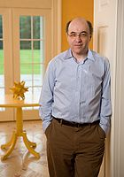
About Wolfram Alpha:
Wolfram Alpha was created by British physicist Stephen Wolfram
Wolfram Alpha was made available on May 15, 2009
Gives mathematical data for any input that can be computed
www.wolframalpha.com

Slide 3
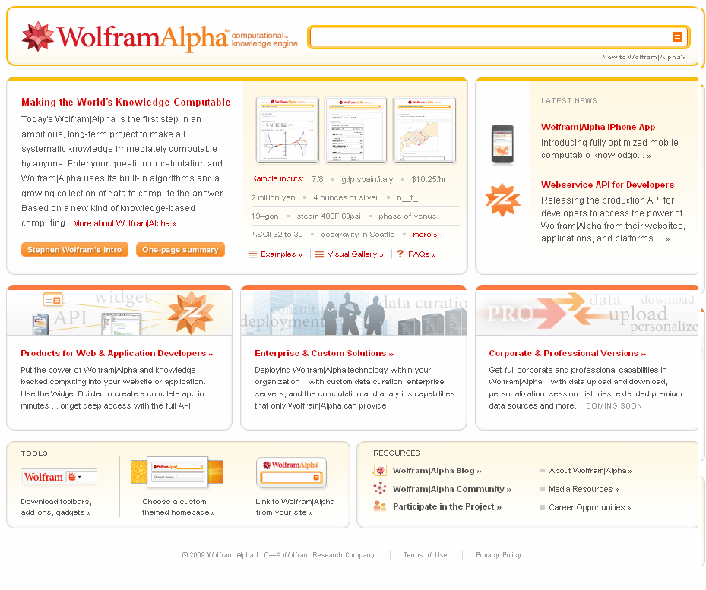
Wolfram Alpha Site:

Slide 4

Let’s See What Wolfram Alpha Can Do: Bell Ringer
What is your name?
Type in: “Kristin”
Wolfram Alpha

Slide 5
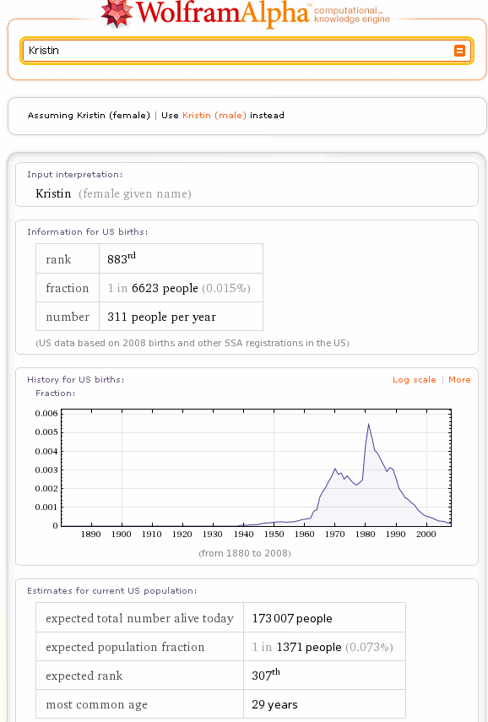

Slide 6

Let’s See What Wolfram Alpha Can Do: Bell Ringer
Where am I?
Type in: “Where am I?”
Wolfram Alpha

Slide 7
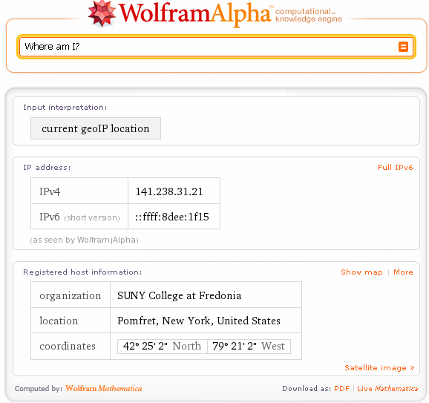

Slide 8

Scavenger Hunt
Introduce a new topic: Give students a preview of what they will be learning in class.
Scavenger Hunt: Cover important Geometry vocabulary from a New York State Geometry Exam

Slide 9
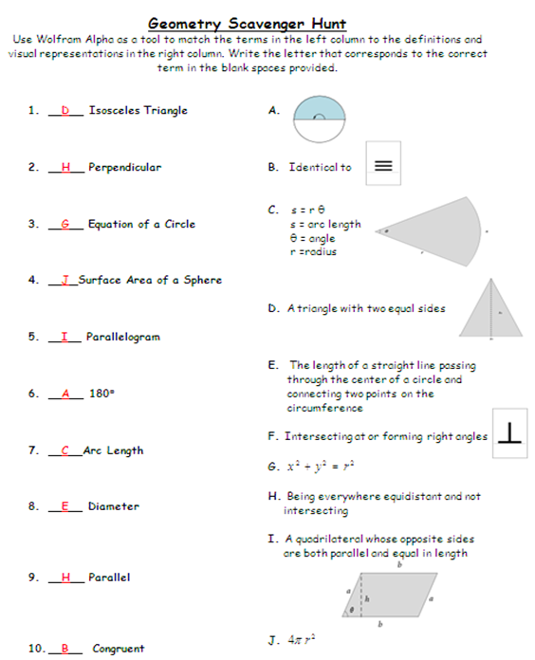

Slide 10
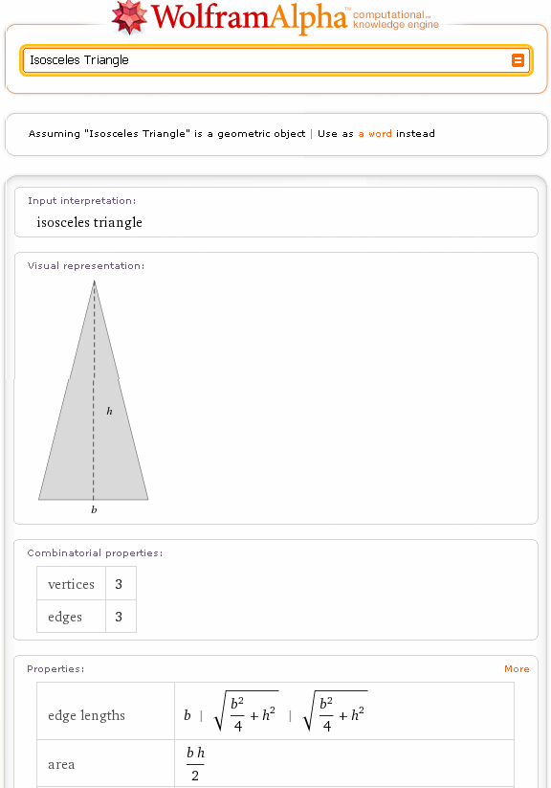
Geometry Scavenger Hunt:

Slide 11
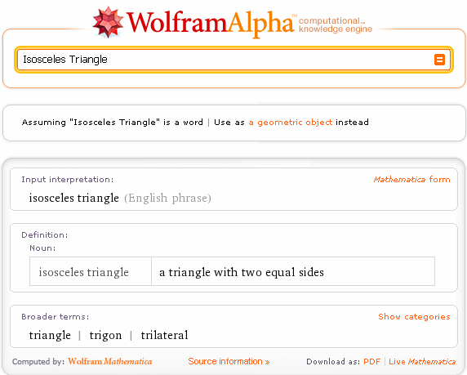

Slide 12
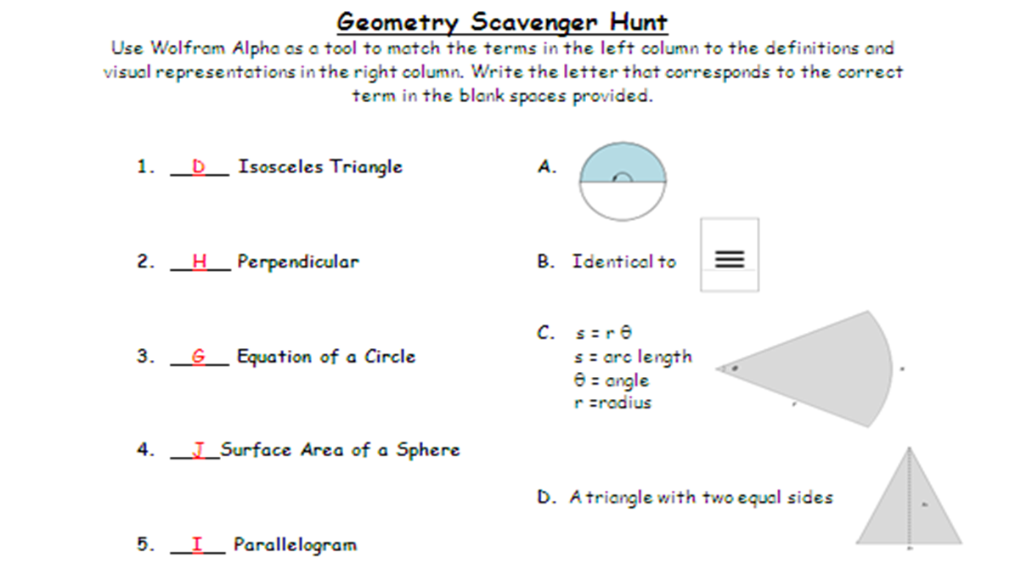

Slide 13

Regents Review:
(Integrated Algebra: June 2009 Exam)
What are the roots of the equation
?
(1) 1 and 7 (3) −1 and −6
(2) −1 and 7 (4) 1 and 6
Regents Answer: (4) 1 and 6

Slide 14

Result: From Wolfram Alpha
Type in: x^2 − 7x + 6 = 0
OR
Type in: x squared minus seven x plus six equals zero into Wolfram Alpha

Slide 15
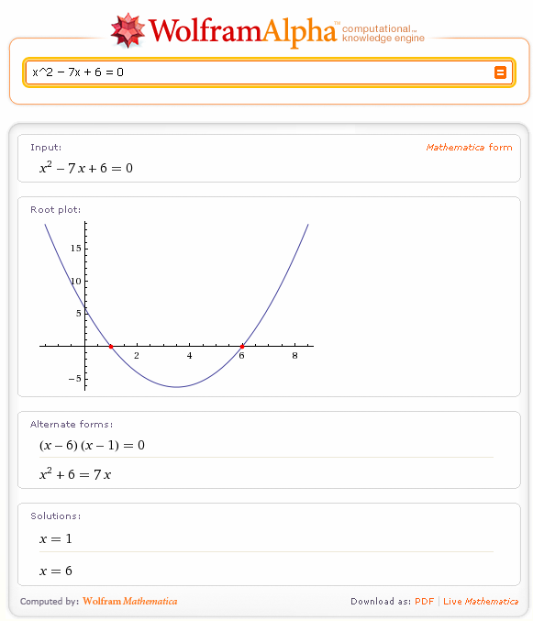

Slide 16

Regents Review:
(Math B Exam: June 2009)
When the sum of −4 + 8i and 2 − 9i is graphed, in which quadrant does
it lie?
(1) I (3) III
(2) II (4) IV
Regents Answer: (3) III

Slide 17
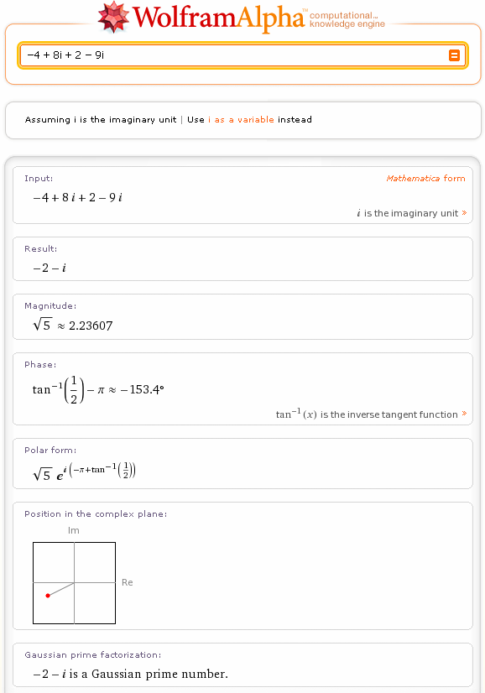

Slide 18

Regents Review
(Math B Exam: January 2008)
The expression cos (π – x) is equivalent to
(1) sin x (3) cos x
(2) –sin x (4) –cos x
Regents answer (4)

Slide 19
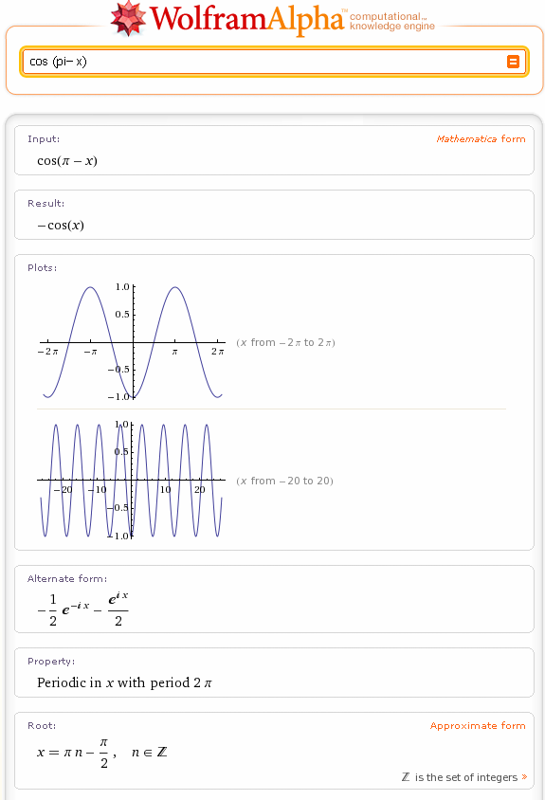

Slide 20
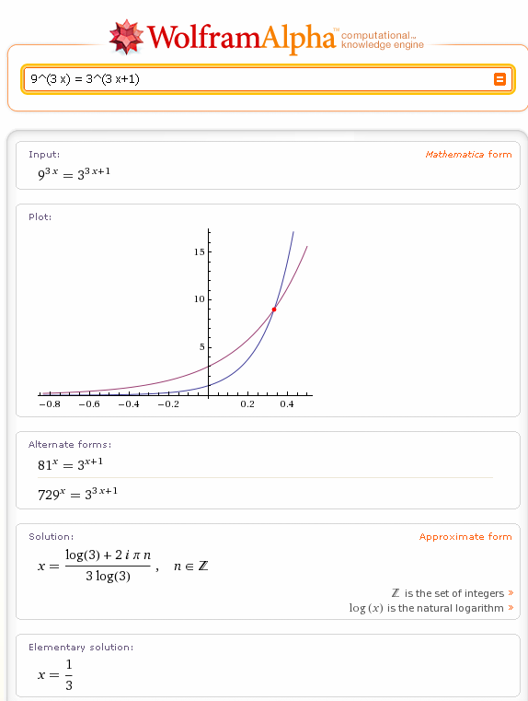
What you might find…

Slide 21
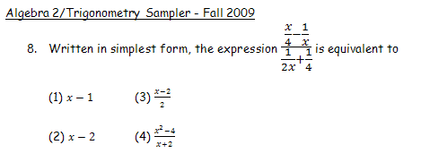

For Example:

Slide 22
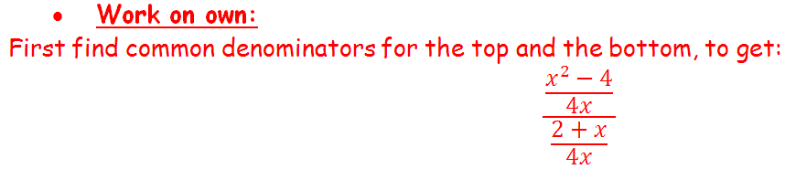
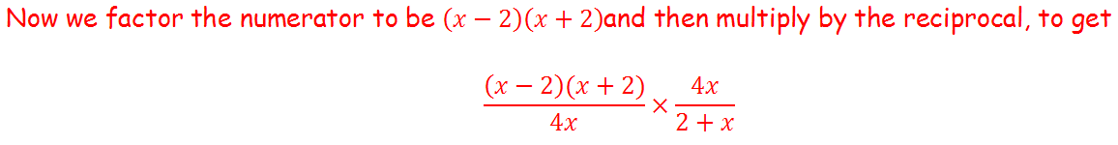
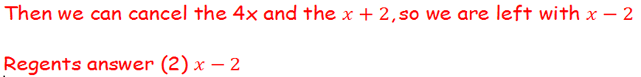


Student Work:

Slide 23


Thank You for Attending Our Presentation
We would be happy to answer any of your questions.

