Slide 1
AMTNYS 2009
SUNY Fredonia
WORK
Kristi Jo Bockhahn,
Hallie Johns, & Allison Spencer

Slide 2
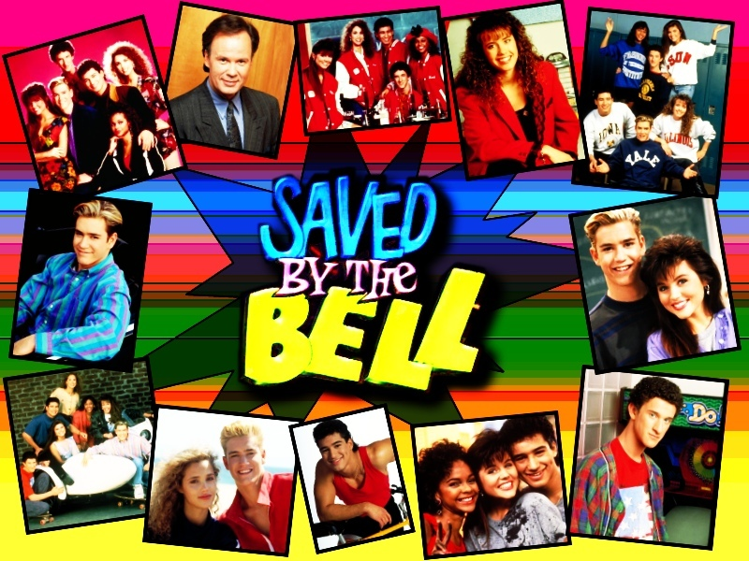

Slide 3
Why Bell Work?
Using bell work in the classroom can…
provide structure
capture students’ interests
increase participation
provide real-world connections
help prevent disruptions
allow time for teacher’s housekeeping tasks

Slide 4
A “New Class” of Bell Work
Bayside Picks-“Drops in the Bucket”
Bayside News
QQF: Bayside History

Slide 5
Quote:
“A person who never made a mistake never tried anything new.”
-Albert Einstein
Question:
What was one of Einstein’s contributions to mathematics?
Fact:
There is a rare radioactive earth metal named after Einstein.
Notes:
Einsteinium

Slide 6
A “New Class” of Bell Work
Bayside Picks-“Drops in the Bucket”
Bayside News
QQF: Bayside History
Lists
Problem of the Day (POD)

Slide 7
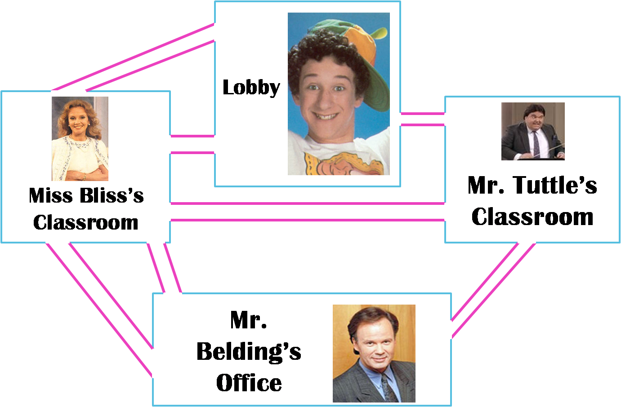
Classroom Confusion
Can Screech start at the Lobby, visit every room using each hallway only once, and end up back at the Lobby?

Slide 8
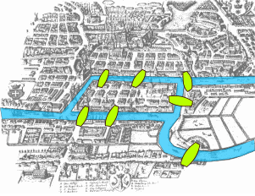
KÖnigsberg

Slide 9
Some History of the Königsberg Bridge Problem
Brought forth the first theorem of graph theory
Located in present-day Kaliningrad, Russia
How many bridges are left today?
Notes:
All seven bridges were destroyed by an Allied bombing raid in 1944 and only five were rebuilt. Now it is possible to visit the five rebuilt bridges via an Euler path (route that begins and ends in different places), but there is still no Euler tour (begin and end at the same place.

Slide 10
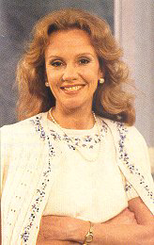
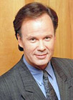
Lobby
Miss Bliss’s
Classroom
Mr. Tuttle’s
Classroom
Mr. Belding’s
Office

Slide 11
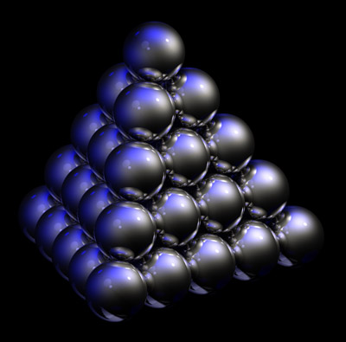
Stackable Spheres
How many spheres are there in this pyramid?

Slide 12
1²
2²
3²
4²
5²
55

Slide 13
Stackable Spheres
How many spheres are there in this pyramid?
1²+2²+3²+4²+5²=55
What if we add another layer?
55+6²=91
What if we add 3 layers to the original pyramid
(8 layers)?
55+6²+7²+8²=204
What if we add 50 layers to the original pyramid (55 layers)?

Slide 14
Executive Producers:
Kristi Jo Bockhahn
Hallie Johns
Allison Spencer

