Slide 1
“Picture-Perfect”
Jennifer Burr
Sarah Taylor
Michelle Swackhammer
59th Annual AMTNYS Conference
November 2009
SUNY Fredonia

Slide 2
Hands on Math!
What kind of simplification can be completed with these foods?
Reaching out to students with different learning styles
I have an allergy in my classroom. What can I do?

Slide 3
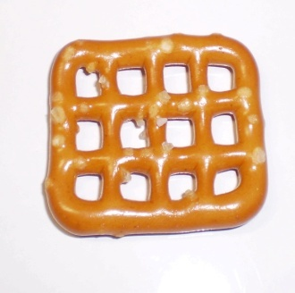
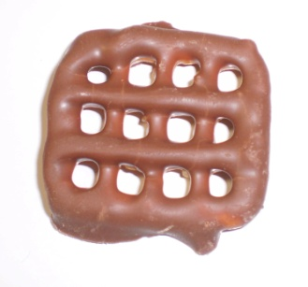
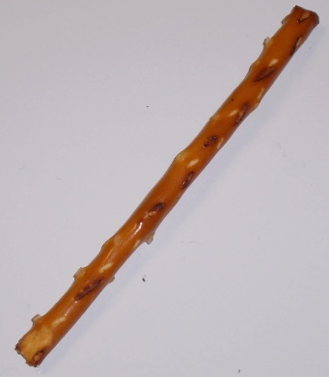
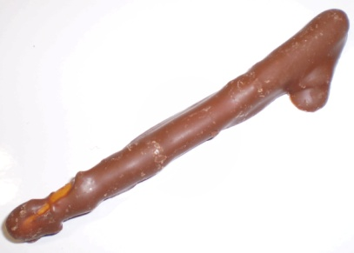
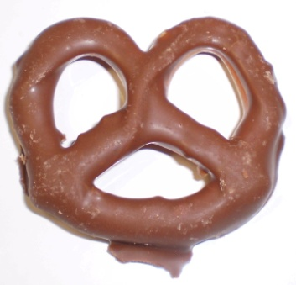
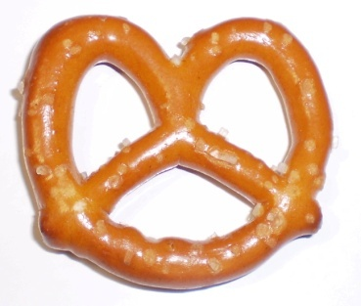
Representation

Slide 4
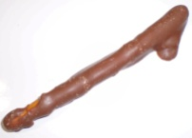
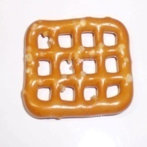
Working Together

Slide 5
Zero Pairs
Looking at our Pretzels we have a few zero pairs. What is a zero pair?
+ = zero pair
+ = zero pair
+ = zero pair

Slide 6
Solution
After we remove all of our zero pairs we are left with:

Slide 7
How about an example?
Now you try one!
Solution:
"Picture-Perfect" Pretzels

Slide 8
Enjoy the Presentation?
If you enjoyed our presentation feel free to help yourself to a copy of our lesson plan. Or, you are more than welcome to contact us at:
Jennifer Burr: burr0996@fredonia.edu
Sarah Taylor: tayl0435@fredonia.edu
Michelle Swackhammer: swac6637@fredonia.edu

