Slide 1
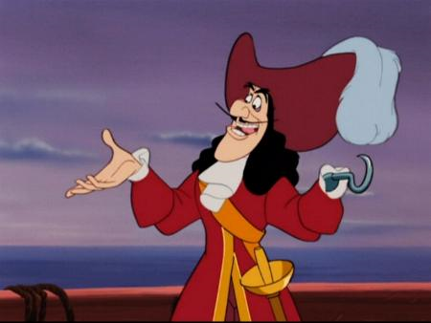
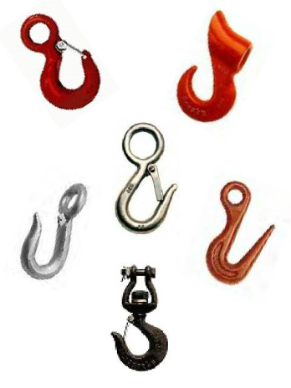
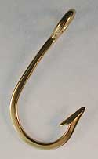
Hot Hooks
By
Gregory Cotton
Eric Johnston
Joshua Sadler
AMTNYS 2009
SUNY FREDONIA

Slide 2
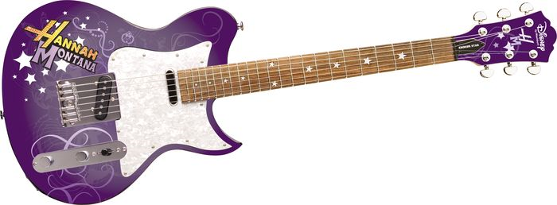
Who Is Hannah Montana?
Singer
Actress
Teen Idol
Mathematical Hook?
Nielson Ratings For Hannah Montana:
Season 2: 4.5 Millions Viewers*
Season 3: 5.3 Million Viewers*
Season 4: 5.7 Million Viewers#
Season 5: 6.0 Million Viewers#
Season 6: 5.7 Million Viewers#
*Information Obtained on Average from Nielson Ratings
# Projected Ratings for Future Seasons

Slide 3
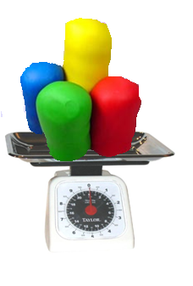
Play
Kitchen
______
_______
+
= ?
Dough
Scale
It equals a fun way to visualize fractions, and add them together.
How does Play Dough help add fractions?

Slide 4
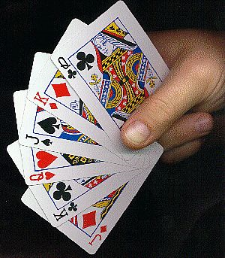
Mathemagician
Is it Magic or Math?
Card tricks are a great way to hook students at any grade level
The real trick is making students realize there is a connection between magic and mathematics.

Slide 5
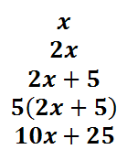
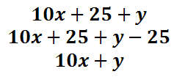
SOLUTION
The first card will be represented by the variable ‘x’
The second card will be represented by ‘y’
Since we know that the deck only contains single digit numbers we see that in our 10’s place we will have our ‘x’ and in our 1’s place we will have our ‘y’, i.e. ‘xy’.

Slide 6
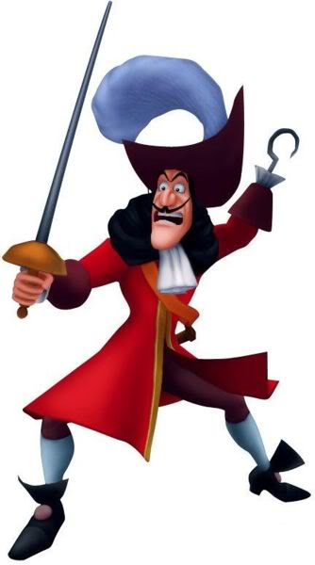
Contact Information
Gregory Cotton cott6397@fredonia.edu
Eric Johnston john8394@fredonia.edu
Joshua Sadler sadl1192@fredonia.edu

