Slide 1
Faster Than a Clicking Thumb and other fun-filled activities for AMTNYS 2009
Jordan Bardo
Paul Chimenti
Don Kirsch
SUNY Fredonia

Slide 2
Ratios, Rates, Proportions
Permeate curriculum
Interdisciplinary
Practical applications
Tangible, hands-on,
Project-based activities

Slide 3
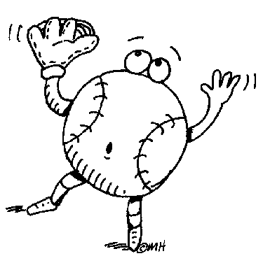
Faster Than a Clicking Thumb
Estimate distance
Throw ball and record speed and time
Calculate distance
Who is most accurate?
Competition

Slide 4
Our Measurements
Name | speed | time | distance
Jordan 1 | 50 | 0.70
Jordan 2 | 45 | 0.93
Jordan 3 | 46 | 0.81
Donnie 1 | 52 | 0.77
Donnie 2 | 42 | 1.09
Donnie 3 | 33 | 1.30
Paul 1 | 51 | 0.75
Paul 2 | 44 | 0.95
Paul 3 | 35 | 1.12
 | speed | time | distance
Jordan 1 | 50 | 0.70 | 51.33
Jordan 2 | 45 | 0.93 | 61.38
Jordan 3 | 46 | 0.81 | 54.65
Donnie 1 | 52 | 0.77 | 58.73
Donnie 2 | 42 | 1.09 | 67.14
Donnie 3 | 33 | 1.30 | 62.92
Paul 1 | 51 | 0.75 | 56.10
Paul 2 | 44 | 0.95 | 61.31
Paul 3 | 35 | 1.12 | 57.49

Slide 5
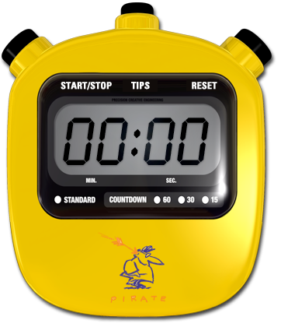
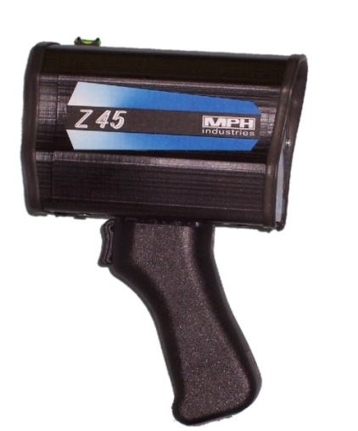
Speed=50mph, time=0.70 sec
First change miles to feet and
hours to seconds
50 mi=50 • 5,280 ft = 264,000 ft
(1 mi=5,280 ft)
1 h = 3,600 sec
Therefore,
50 mph = 264,000 ft/3,600 sec ≈ 73.3 ft/sec
So,
73.3 ft/sec • 0.70 sec = 51.31 ft

Slide 6
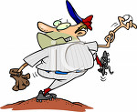
Engage the Entire Class
Everyone participates
Everyone records data
Everyone calculates
Everyone practices ratios and proportions in a fun way!

Slide 7
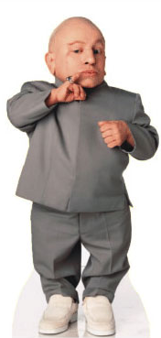
The Rest of our Best
Mixing with DJ Ratio
Use our lesson to whip up the perfect batch
Mini You
Create yourself in smaller form

