Slide 1
Cheesy Fractions
Megan Krotje, Catherine Leichner
& Vanessa Love-McCarthy
SUNY Fredonia
AMTNYS 2009
Buffalo, NY

Slide 2
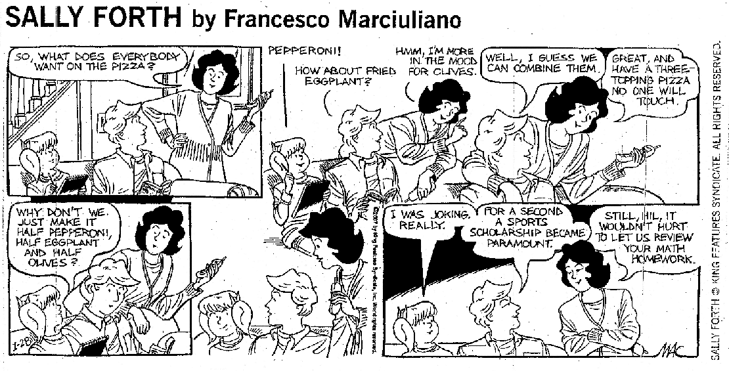

Slide 3
Yankees Win!!!
True or False?
How ‘bout this:
In a traditional July 4th double header against the Cleveland Indians, Yankees captain Derek Jeter goes one for three in the first game and one for four in the second game. What’s his batting average for the day?

Slide 4
Common Misconceptions
Treating fractions the same way as whole numbers.
Example:
Common Student Mistake:
1 unit =

Slide 5
Common Misconceptions
Fill in the box with either >, <, or =
Example:
Common Student Mistake:
Why do you suppose students might answer this way?
What words associated with this problem could be confusing for students?

Slide 6
Common Misconceptions
Use of the word “cancelling”
Example: explain why
Without explicitly writing out the factored form, the whole operation of “cancelling” seems mysterious to students.

Slide 7
Common Misconceptions
Common student mistake:
The student incorrectly computed:
Correct computation:
Use pattern blocks to model improper fractions
Procedural computations versus number sense

Slide 8
Helpful Hints for Teachers
Use multiple representations of fractions. These could include a wide range of shapes, use of pattern blocks, words, symbols, and use of fraction tiles.
Clearly define “reduced” and “lowest terms fraction” and explain when they are equivalent.
In the early stages of introducing fractions, write out the denominator in words
4 sixteenths =
5 eighths =

