Slide 1
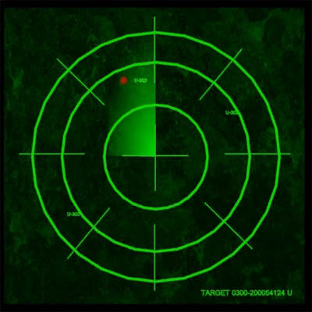
AMTNYS 2009 Buffalo, NY
Cornhole Coordinates
Shane Hood
Brian Morrish Rianne Steenhoff

Slide 2
What are Polar Coordinates?
( , )
r
Ө

Slide 3
History of Polar Coordinates
Bernoulli wrote about Polar Coordinates in 1691.
This Journal is still being published today.

Slide 4
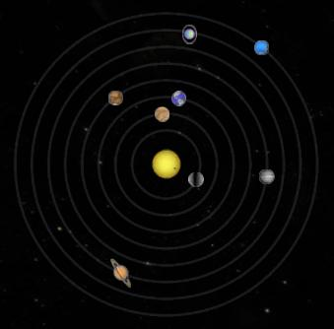
History of Polar Coordinates
Studied orbital motion.
Johannes Kepler’s laws of planetary motion.

Slide 5
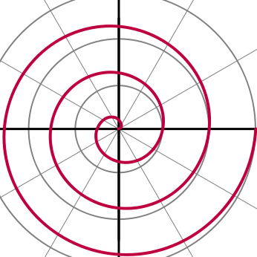
History of Polar Coordinates (Cont.)
Archimedean Spiral
225 BCE “On Spirals”

Slide 6
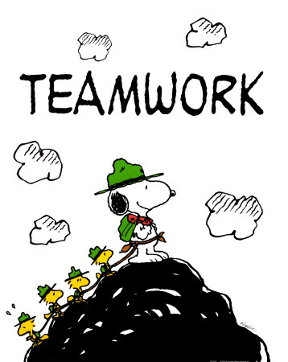
C² In Action
Create a giant coordinate plane on the floor.
Disperse targets throughout the plane.
Teams of four or five.
Each team estimates distance and angle of each target
One point awarded for every correct distance, and every correct angle.

Slide 7
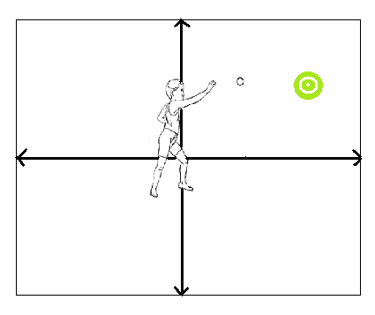
C² in Action
One person stands at the origin.
The person throws a bean bag at the target of their choice.
Each Target has a different point value.
Points awarded iff the team iif they hit the target.

Slide 8
A Sample Lab Worksheet
Throw | Distance from origin (r) | Angle from 0˚ (degrees) | Angle from 0 (radians) | Points Earned From Target | Coordinates
1
2
3
4
5
6
7
8
9
10
 |  |  |  | Total Points:

Slide 9
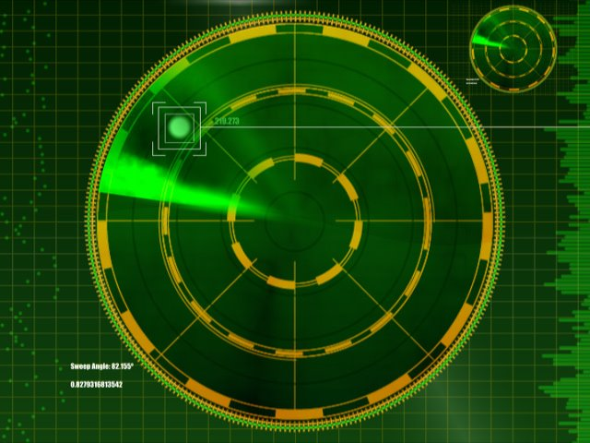
Real Life Applications of Polar Coordinates
Polar coordinates are used often in navigation.
The study of circular and orbital motion.

