Slide 1
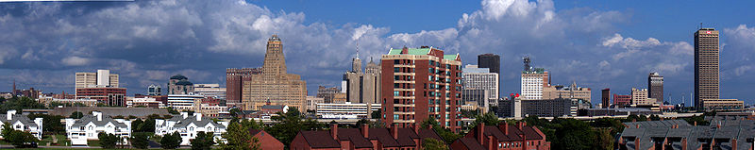
City Skylines
Surface Area Using Nets
Jackie Majka
Ashley Martin
Jennifer Carmello
SUNY Fredonia
AMTNYS 2009

Slide 2
What is a Net?
A net is a flattened out version of a figure that shows each face of the figure and can be “folded up” so that a 3-d figure is created.
When making a net for a 3-d figure, each face must touch another face along at least one edge, and all of the vertices must match up.

Slide 3
City Skylines Project
π The City Skyline project is a great way to incorporate many mathematical concepts into a middle or high school classroom. For Example:
      Area
      Surface Area
      Volume
      Proportions
      Parallel and Perpendicular Lines
  π The Buildings included in this project are:

Slide 4

HSBC Tower

Slide 5
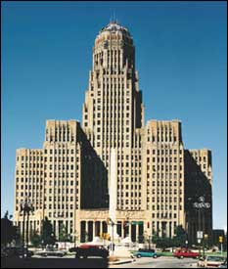
Buffalo City Hall

Slide 6
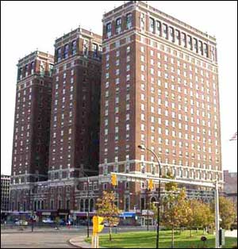
Statler Towers

Slide 7
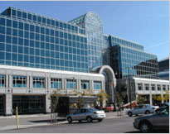
HSBC Atrium

Slide 8
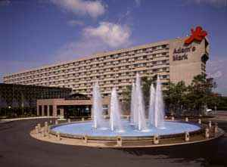
Adam’s Mark Hotel

Slide 9
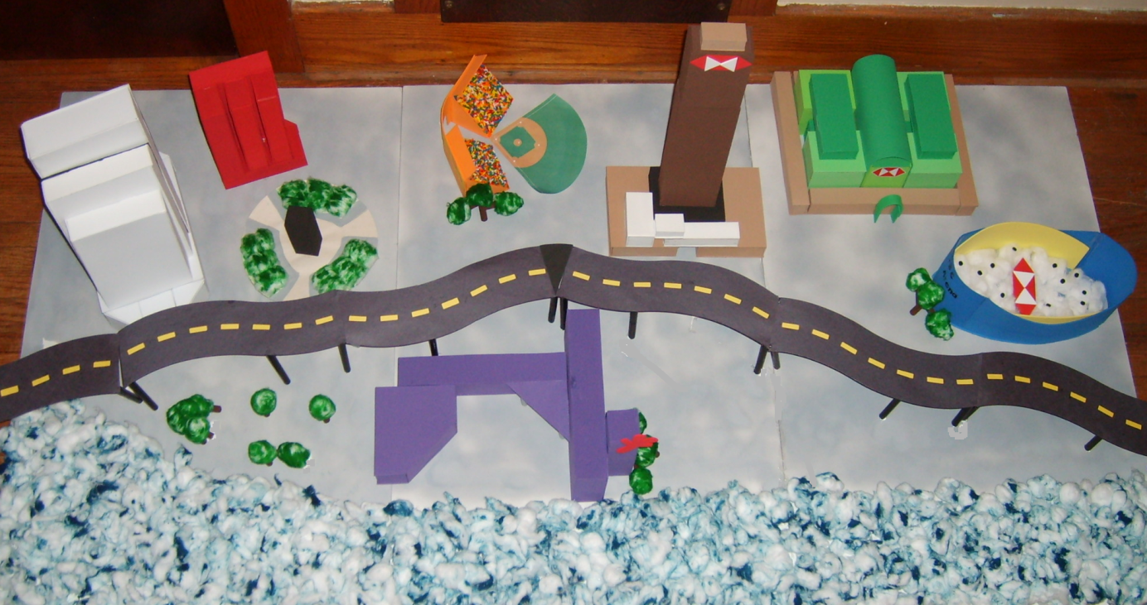
Materials
City Skylines
  Construction Paper/Foam Board
  Pencils/Markers
  Graph Paper
  Glue/Tape
  Scissors
  Ruler

Slide 10
Net for the United Nations Building
2 x 11 blocks
9 x 11 blocks

Slide 11
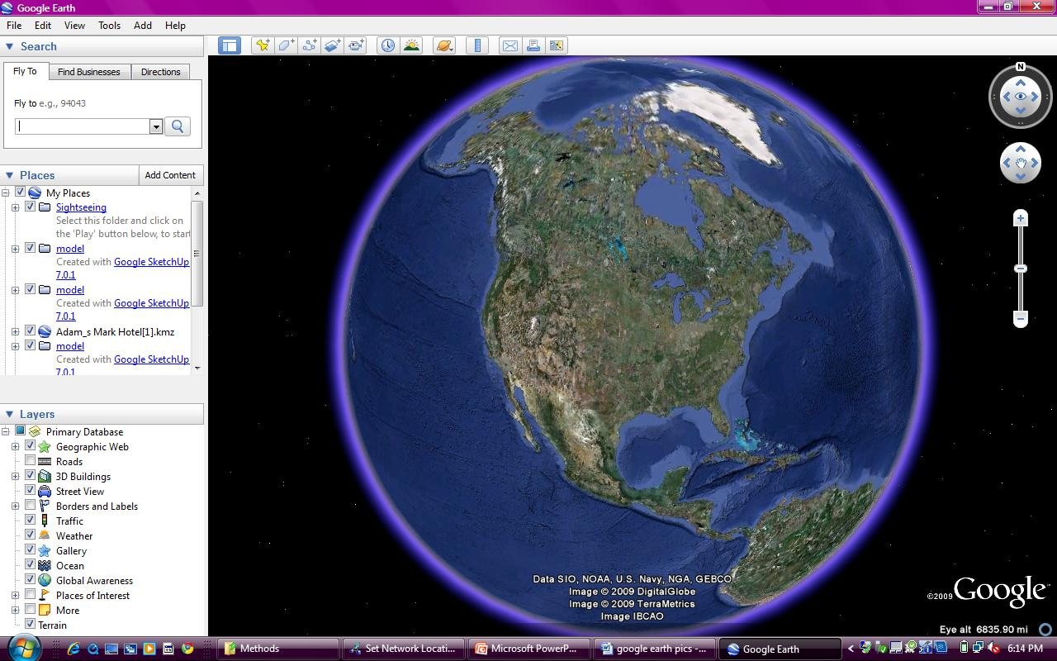
Google Earth

Slide 12
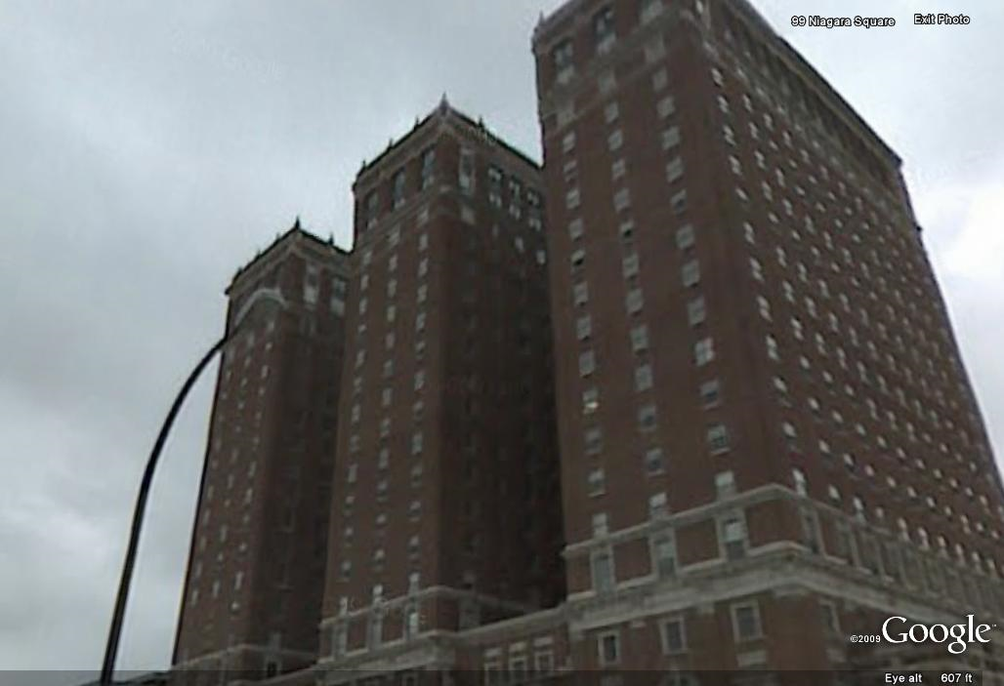
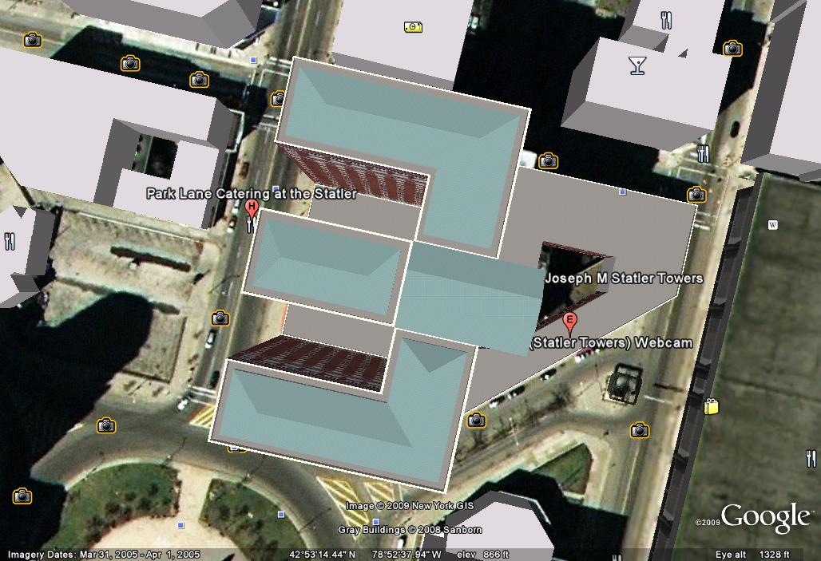
Statler Towers

Slide 13
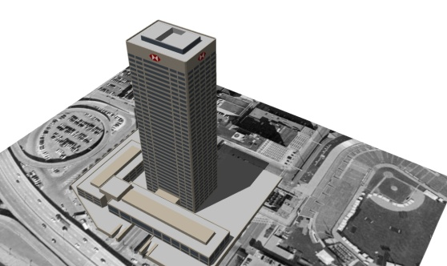
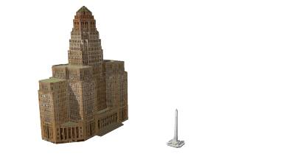
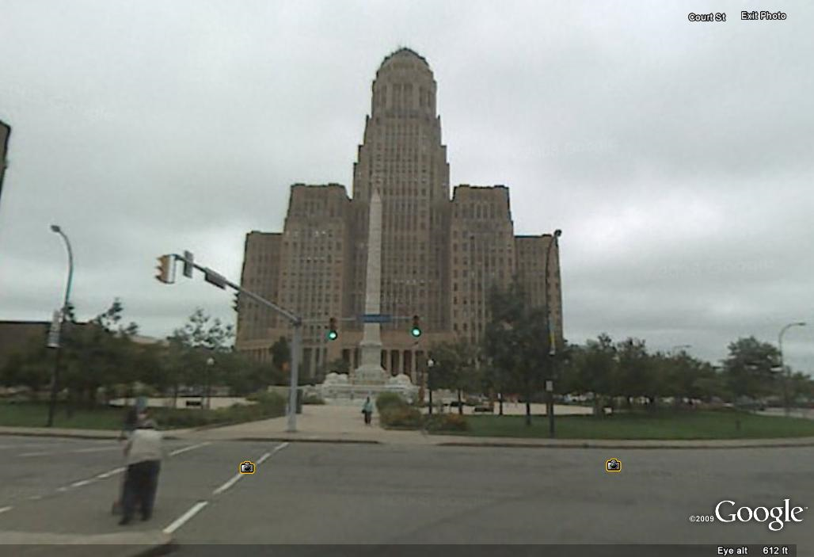
HSBC Tower
&
Buffalo City Hall

Slide 14
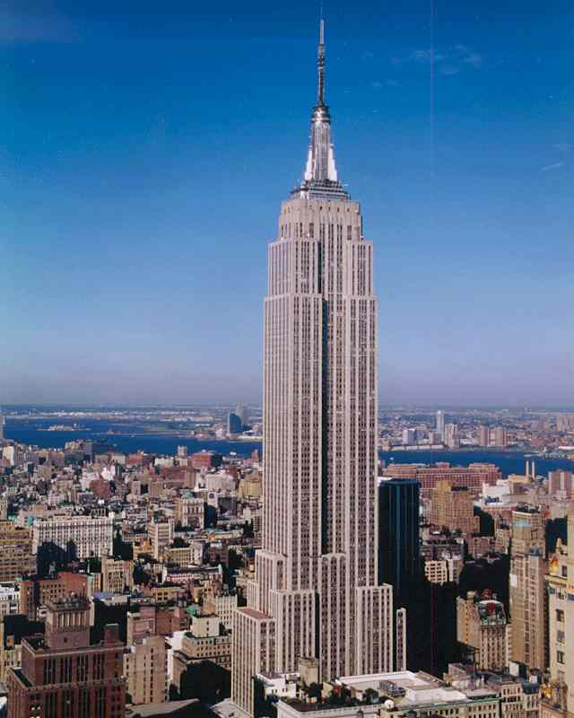
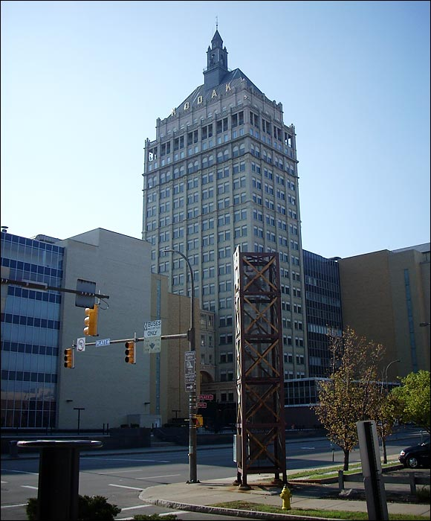
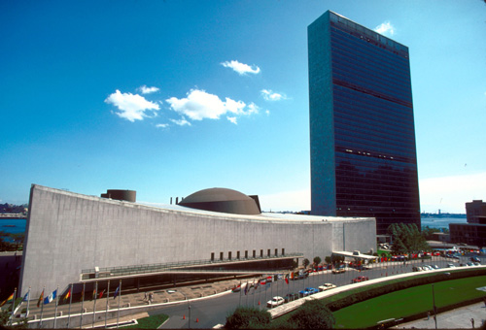
Make It Take It
Join us from
You could have a chance to win the…
Friday 2 – 2:55pm
Richardson Room
United Nations Building
Empire State Building
Kodak Building
City Skylines

